Slide 1


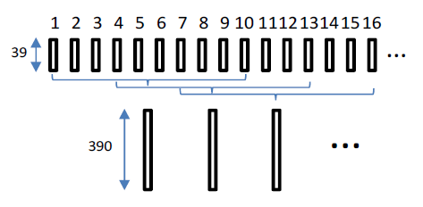
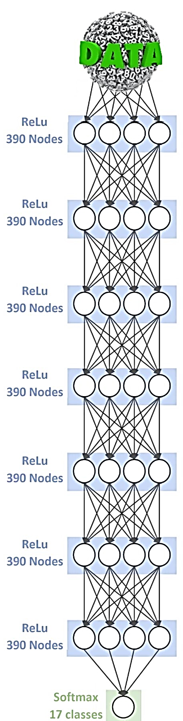
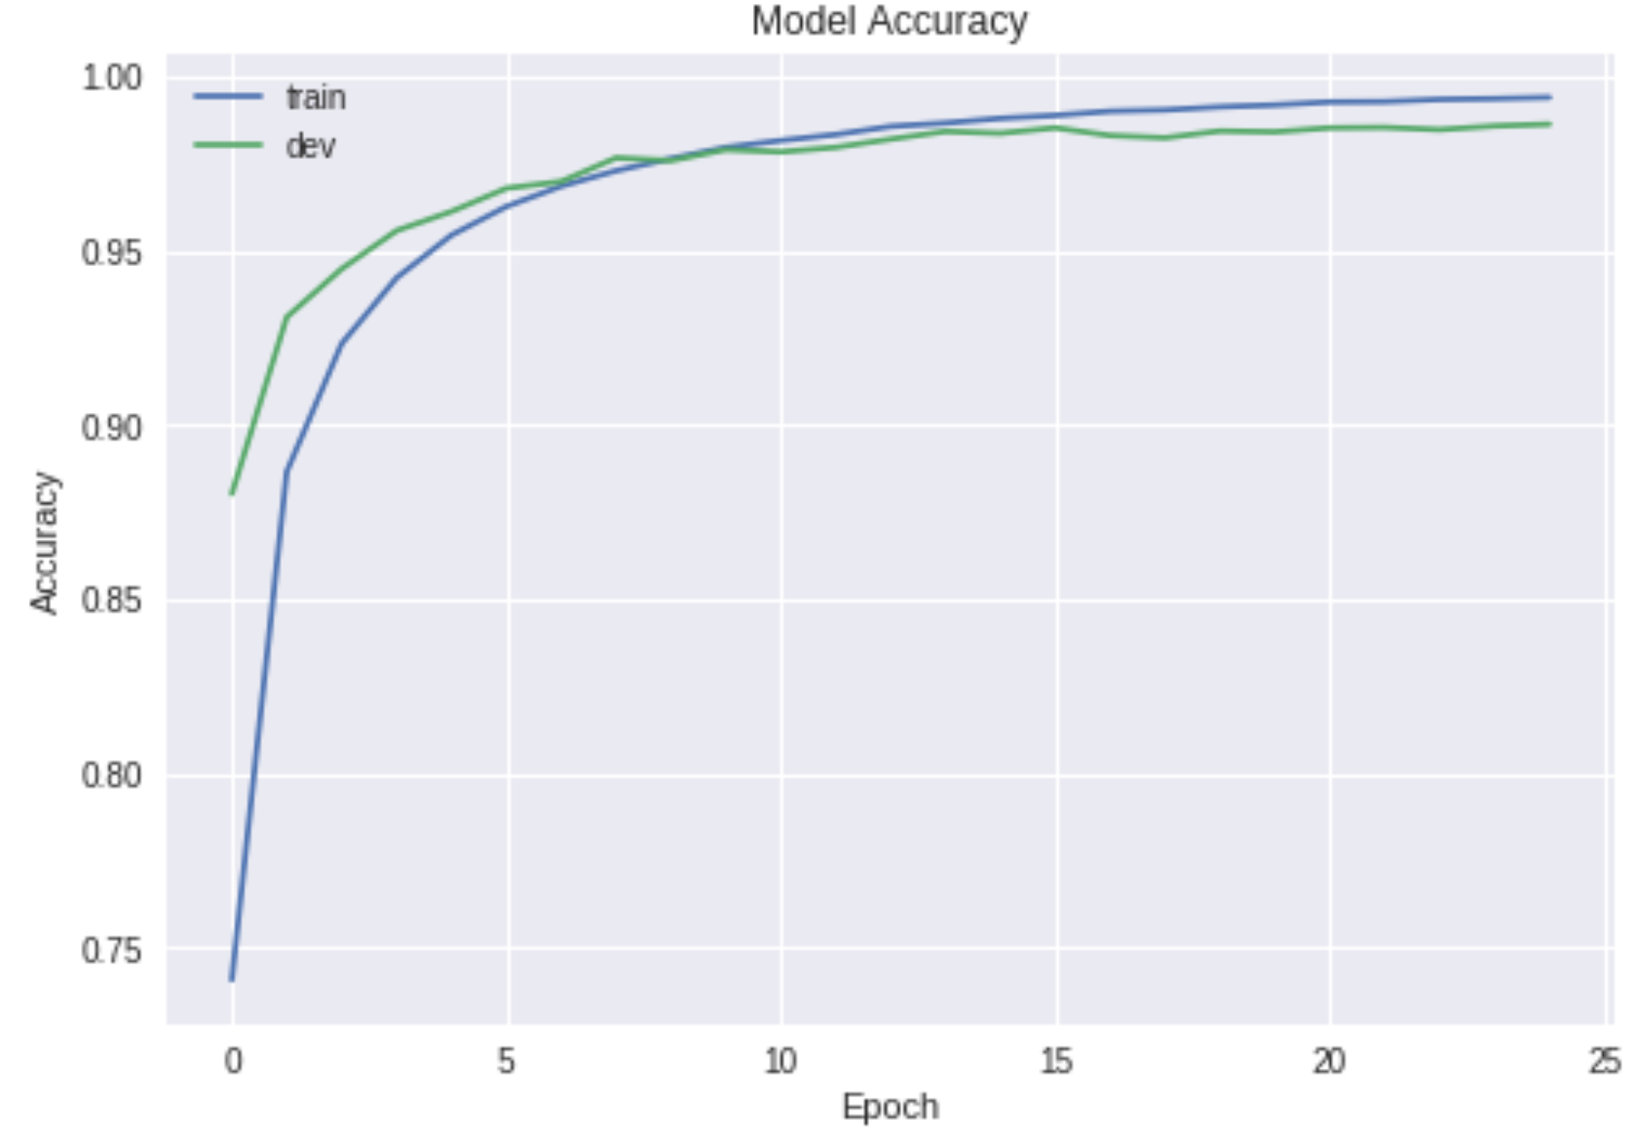
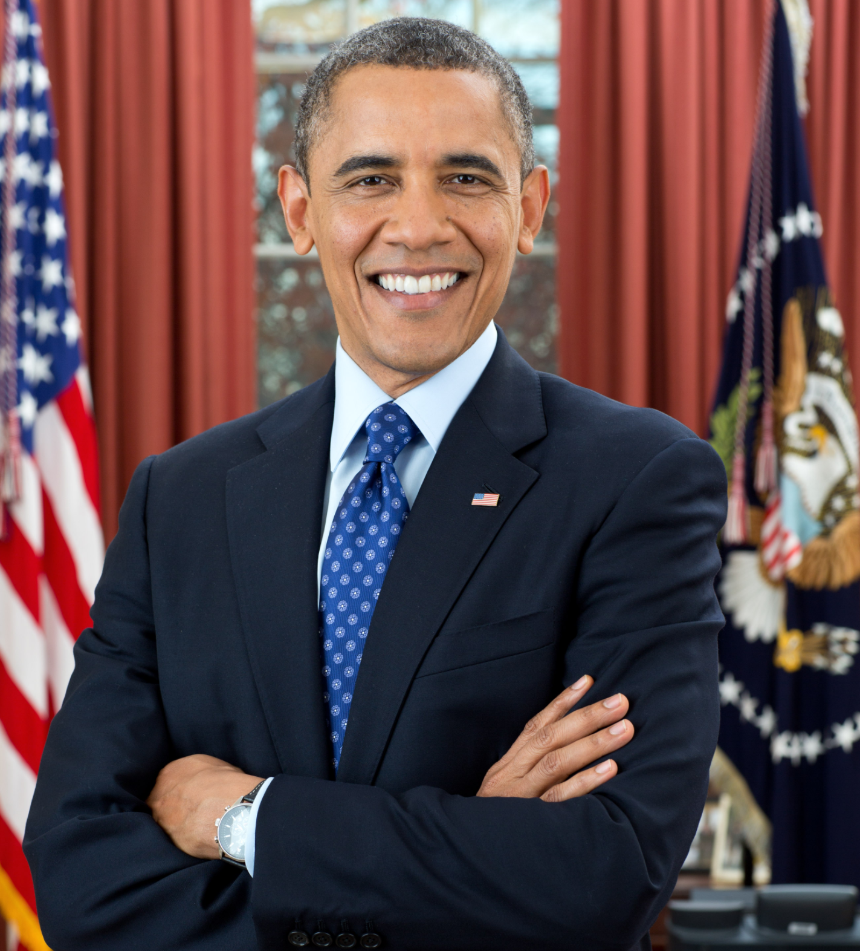
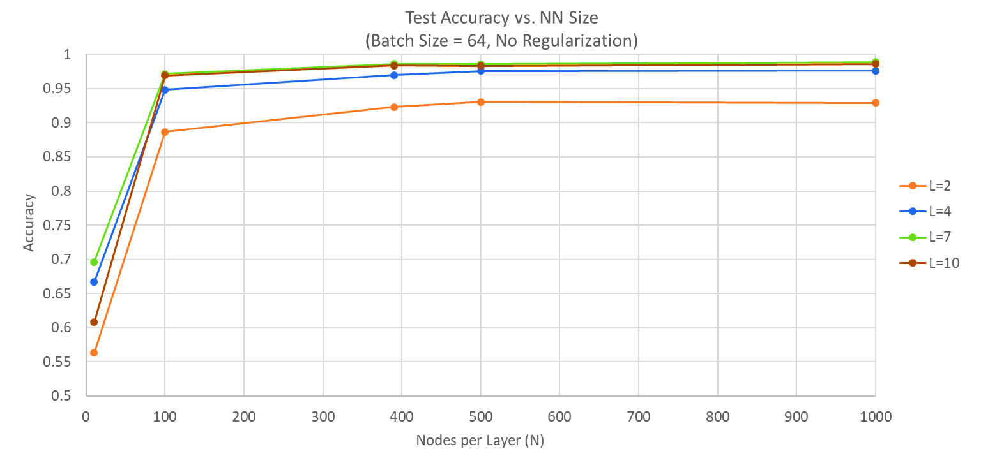
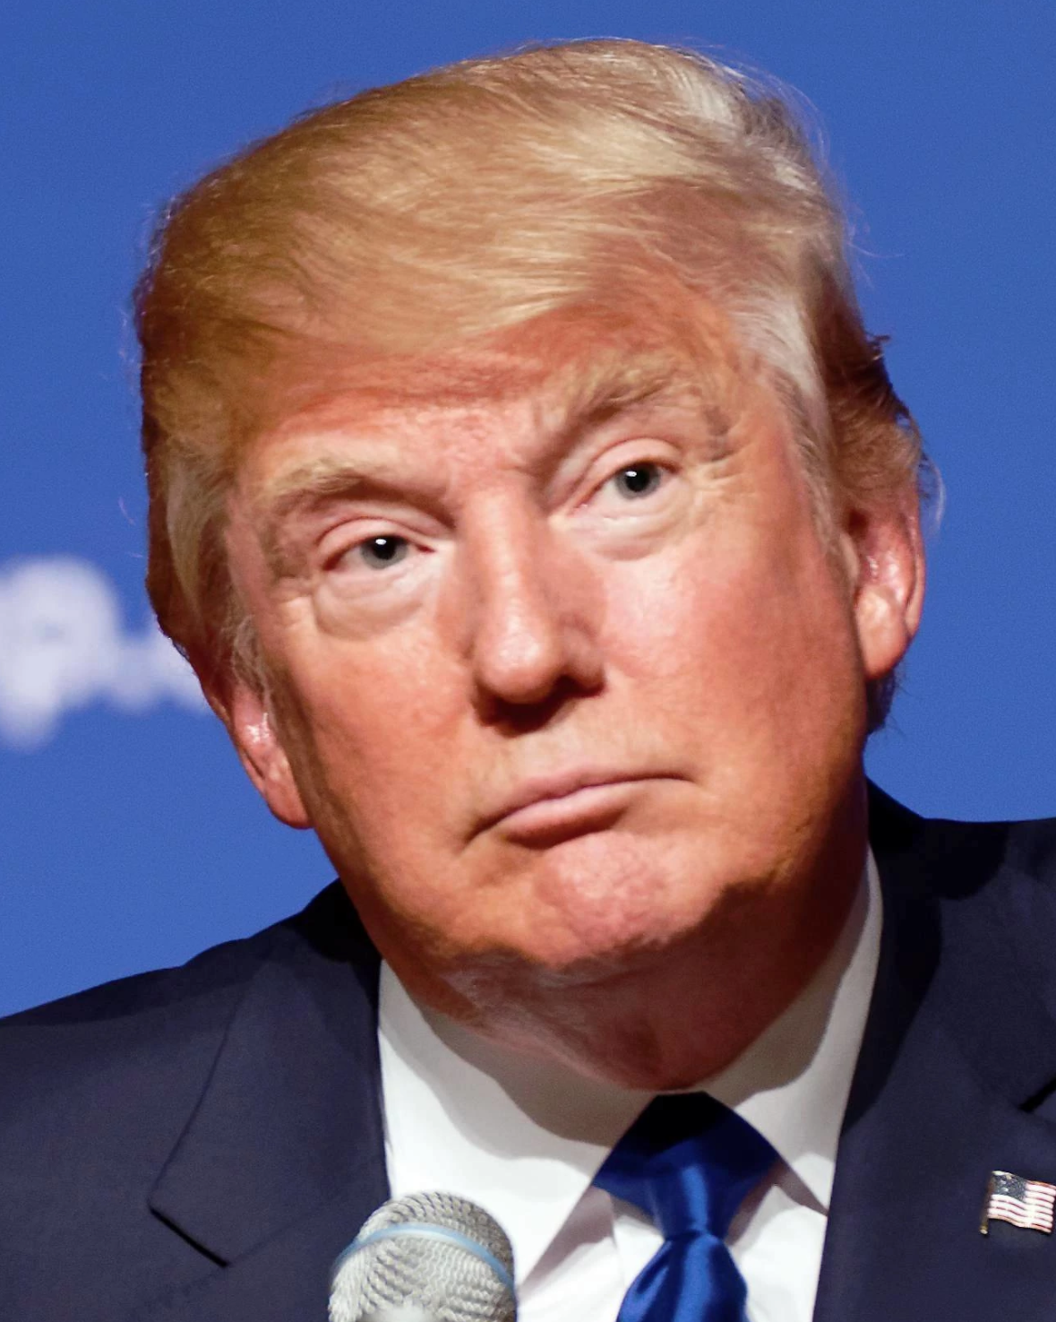
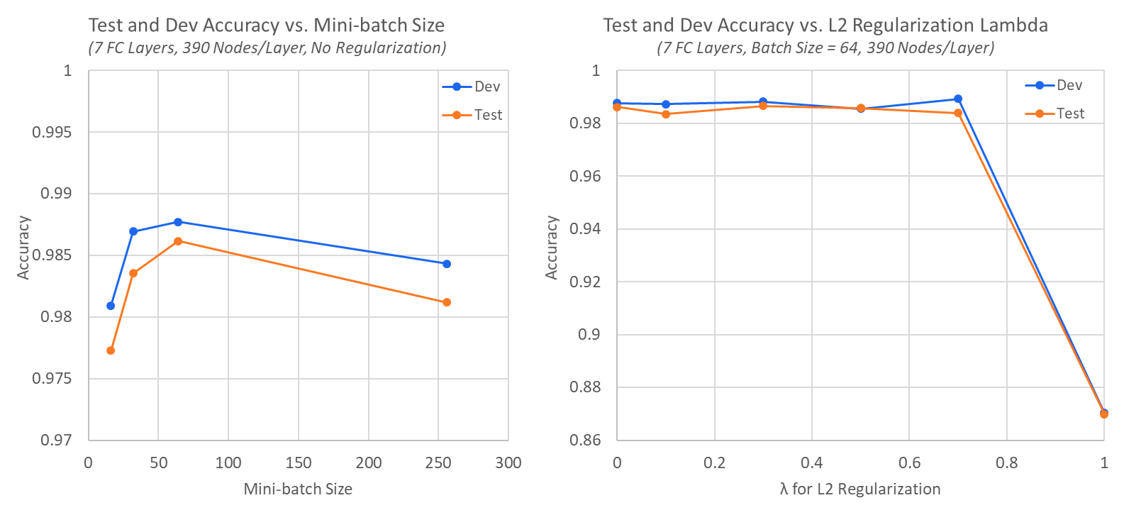

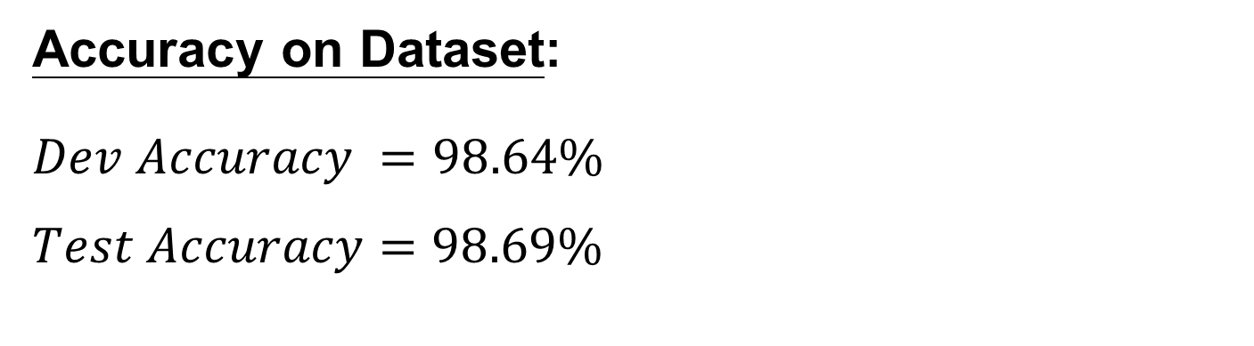
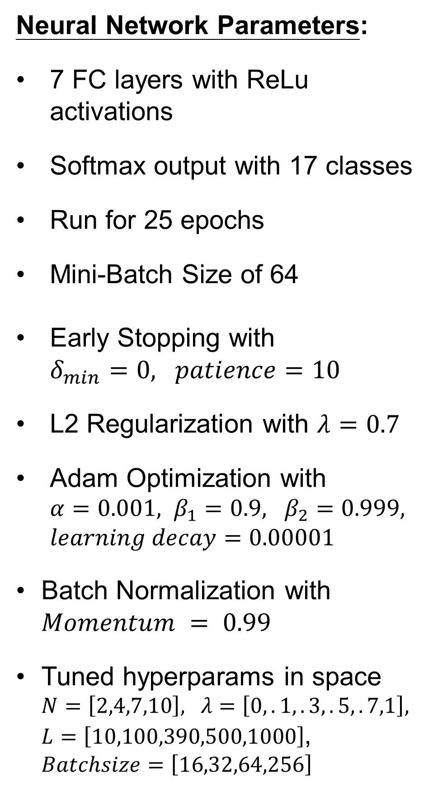
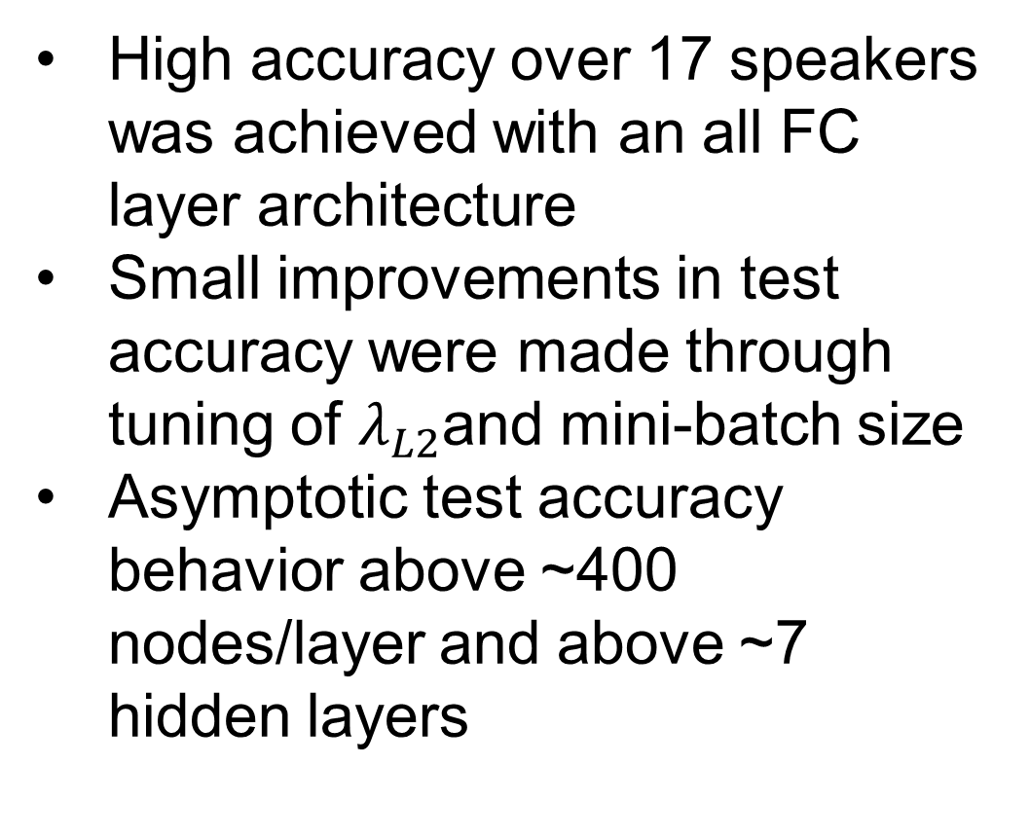
Intelligent Voice Identification
with Neural Networks
Lloyd Maza (lmaza) - Michael Thompson (mt1) - David Troner (dtroner)
CS 230 Final Project, Winter 2018
Motivation
Pre-Processing
Conclusions
Automated speech recognition is commonplace in dozens of technology domains. There are many potential applications for automated speaker recognition:
Automated air traffic control
Over-the-phone identity verification
Speaker diarization for speech-to-text
Mel-Frequency Cepstral Coefficients
Need to represent data in a tractable way for a simple NN
MFCCs are the standard in speech recognition tasks
Derived from audio frequency content
Modeled after human auditory system
Extracted in sliding windows
Uniformly scale audio amplitude
Remove unvoiced audio with voice activity detection (VAD)
Extract MFCCs and their derivatives for each window
Normalize speaker feature sets
High accuracy over 17 speakers was achieved with an all FC layer architecture
Small improvements in test accuracy were made through tuning of $λ_{L2}$and mini-batch size
Asymptotic test accuracy behavior above ~400 nodes/layer and above ~7 hidden layers
Frame: 10 ms
Window: 10 frames
Stride: 3 frames
Architecture
Results
Dataset
Neural Network Parameters:
7 FC layers with ReLu activations
Softmax output with 17 classes
Run for 25 epochs
Mini-Batch Size of 64
Early Stopping with $δ_{min}=0, patience=10$
L2 Regularization with $λ=0.7$
Adam Optimization with $α=0.001, β_{1}=0.9, β_{2}=0.999, learning decay=0.00001$
Batch Normalization with $Momentum = 0.99$
Tuned hyperparams in space $N=\left[2,4,7,10\right], λ=\left[0,.1,.3,.5,.7,1\right], L=\left[10,100,390,500,1000\right]$, $Batchsize=\left[16,32,64,256\right]$
Accuracy on Dataset:
$$Dev Accuracy =98.64\%$$
$$Test Accuracy=98.69\%$$
Future Work
Audio clips of 17 people’s voices
About 10 minutes of audio per person
Audio collected from YouTube
Expand dataset to include more people
Introduce “unknown” class
Real-time speaker prediction
Deeper hyperparameter search
Automated sub-captioning
Dataset breakdown: 95% train, 2.5% dev, 2.5% test
Per person: 9.5 min of training audio, 15s for dev, 15s for test
References
Varying degrees of background noise
Only one person speaking at a time
Examples: Trump, Obama, characters from The Office
[1]: Z. Ge, A. Iyer, S. Cheluvaraja, R. Sundaram, A. Ganapathiraju, "Neural Network
Based Speaker Classification and Verification Systems with Enhanced Features," in
Intelligent Systems Conference, London, UK, September 7-8, 2017.

